Slide 1


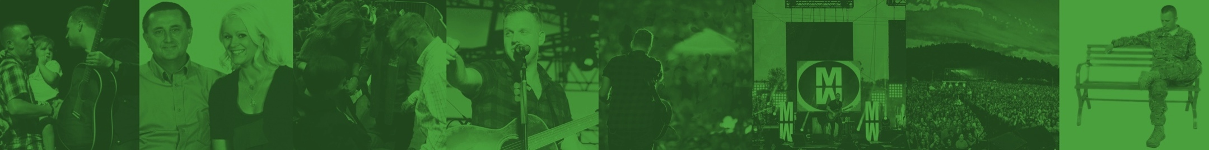


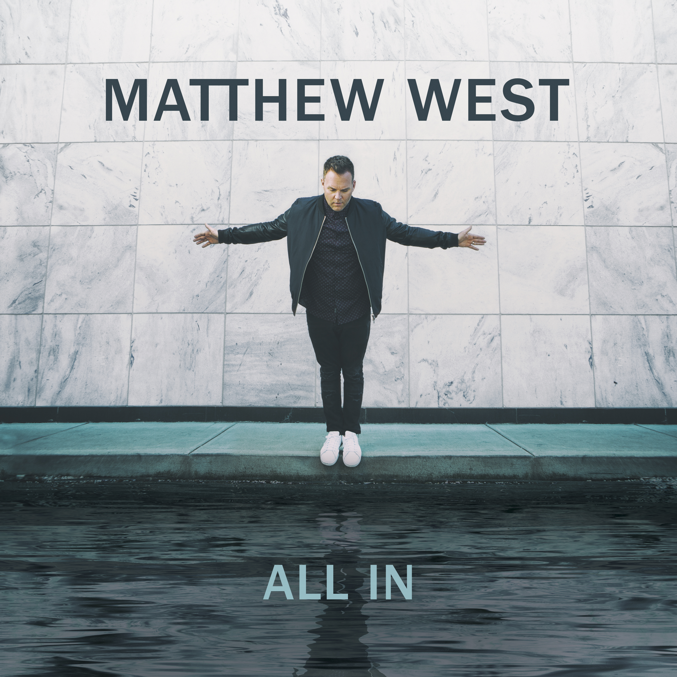
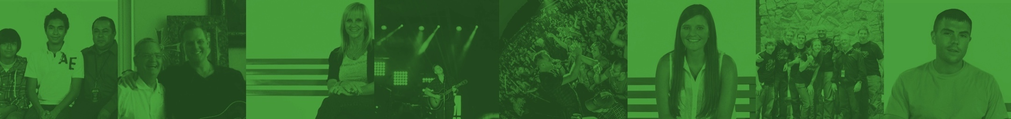

As each has received a gift, use it to serve one another,
as good stewards of God’s varied grace.
1 Peter 4:10
2017 REFRESHER SESSION
welcome to the
GROUND TEAM
2017 - ALL RIGHTS RESERVED.
Notes:
As a reminder – be sure to play Matthew West’s CD, or your favorite Matthew West online streaming station, as guests are arriving to help set the tone for the session.
Greet your team as they arrive and welcome them - introduce yourself to anyone you haven’t worked with before.
Once everyone is seated and you are ready to begin, call their attention to the scripture verse at the top of this slide.
Thank them for coming forward to use their gifts to be part of this ministry!

Slide 2
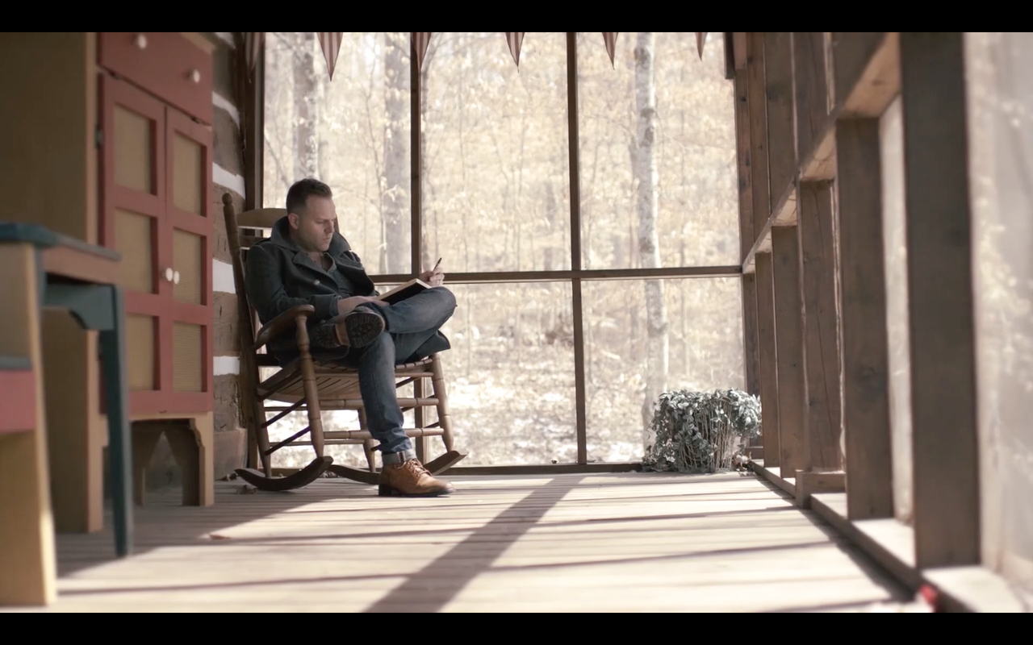
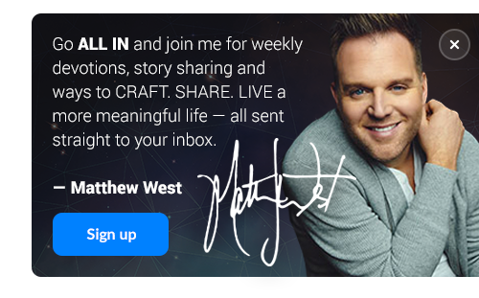
Click video to play
Learn how popwe started
Learn how popwe serves
Call to Action
Notes:
“To help INTRODUCE us to the mission of popwe, let’s listen to Matthew West share the story behind his call to build this ministry.”
Play the Intro video.
Click on the video thumbnail to play the video. (If you click elsewhere on the slide, it will end the slideshow.)
After the video, you may want to say something like:
“Now, let’s take a deeper look at how Matthew West’s ministry, popwe, serves.”

Slide 3
The 4 ways popwe serves
popwe serves with Ground Team members to pray for those who request prayer and further follow up after Matthew West concerts and events
Concert Prayer Ministry
popwe features stories on our website of God’s great impact in the world in hopes that others will share their stories with the world.
POPWE.ORG
Storytelling
Portal
popwe creates a free weekly DAY ONE DEVOS, as well as resources to teach people how to CRAFT. SHARE. and LIVE. a more meaningful story with their lives.
Ministry
Resources
popwe has relationships with other ministries that we partner with prayerfully and financially and are able to refer people to these ministries based on their specific needs and resources.
Feeder
Foundation
Notes:
The purpose of this slide is so that the Ground Team can be informed about popwe and be able to share that information with those who ask about popwe during the concert.
Read through each way popwe serves
- You can let people know that they can visit popwe.org for a deeper look into the 4 ways we serve and to see the resources we offer.
- After this slide, you may want to say something like:
“During Matthew’s concerts, Matthew shares the inspiration behind many of his songs that have been written based on powerful stories of God’s great impact in people’s lives. Many members of the audience are affected by these stories in profound ways and will be inspired to seek prayer or help if they can relate to those stories. Let’s take a look at one of those stories:”

Slide 4

popwe’s Statement of Faith
We believe there is one God.
2. We believe that salvation is available to anyone who believes in Jesus.
3. We believe the Bible is the infallible Word of God and the ultimate source of truth.
4. We believe that God still works in our lives in incredible ways.
5. We believe that Heaven is the hope.
WE BELIEVE…
Make sure you get a copy of popwe’s Statement of Faith from your Ground Team Leader!
Notes:
Pass out copies of the statement of faith to each Ground Team Member.
Because we are representatives of Matthew West’s ministry at the concert, it is important for us to know and represent what popwe believes.
Give everyone time to read over the Statement of Faith and read this slide aloud to them. Once everyone has had time to look it over, have everyone sign the Statement of Faith and hand them back to you so that you can keep them and bring them to Pastor Joe West at the show, or you can scan them over to erica@populationwe.com.
- After this slide, you may want to say something like:
“During Matthew’s concerts, Matthew shares the inspiration behind many of his songs that have been written based on powerful stories of God’s great impact in people’s lives. Many members of the audience are affected by these stories in profound ways and will be inspired to seek prayer or help if they can relate to those stories. Let’s take a look at one of those stories:”

Slide 5
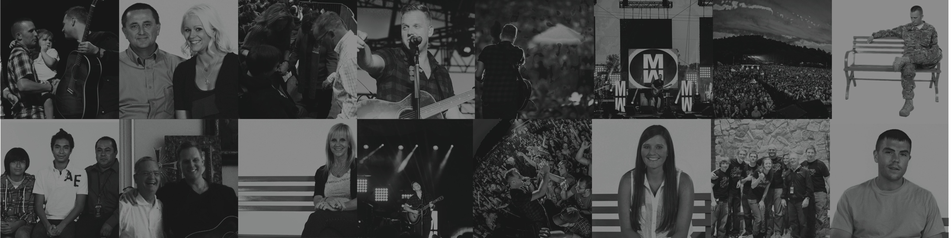
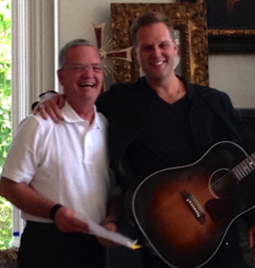
Roles and Responsibilities
ground team
Notes:
“Now that we’ve introduced you to popwe, and been inspired by the “power of story” – let’s shift into our next objective for our session: EQUIPPING you to serve at our upcoming concert/event.”

Slide 6

ENCOURAGE individuals to trust that God is the author of their story
PRAY for those who request prayer during or after the show
REMIND everyone to sign up at popwe.org for complimentary access to DAY ONE DEVOS
EXPLAIN how popwe serves and what resources we offer
PRAY
Together, we will review -
Prayer Resources
Trouble-shooting
Follow-through
YOUR STORY, HIS GLORY
GROUND TEAM
Notes:
Explain that the role of the Ground Team Members at the event is two-fold:
To pray with concert-goers who come forward during and after the show.
Explain how popwe serves and how people can gain access to our free resources
“The primary focus of our role as a Ground Team is to pray with those who come forward. As we discussed earlier, this process can change lives and we hope that you will take what you learn during this session and share with others.”

Slide 7
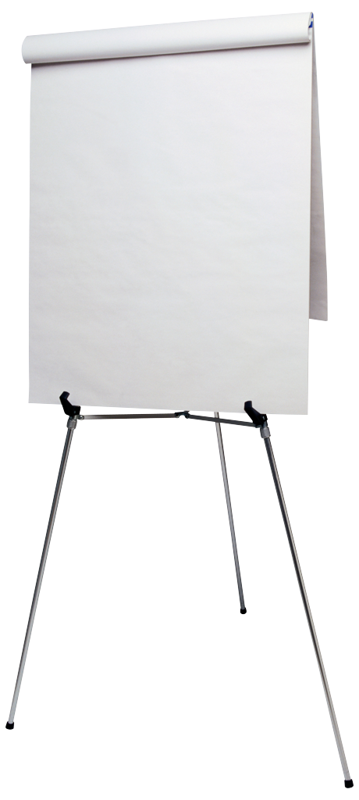
overcoming
I’m not a pastor.
I haven’t been trained.
I don’t know what to say.
I feel “weird” doing it.
What if I say the wrong thing?
I’m not worthy to pray over someone else.
FEAR
About the PRAYER PROCESS
most common concerns
Notes:
“Before we talk about HOW we should pray over others – let’s first talk through some of the potential fears that could be associated with this ministry.”
Note to Facilitator: The goal on this slide is to reassure the group that any fears they might have are totally normal – and shared. Through the next few slides, you will help them realize how they can easily overcome any fears they may have.
- Optional Activity -
If you have a flipchart available, ask the group to brainstorm a list of potential fears about a prayer ministry. This allows them to voice their own concerns.
Once you have a list of 5 or so items, click to display the list in the blue box. Most likely, the two lists will be very similar.
If you choose not to do the optional flipchart activity –
Click to display the list in the blue box and discuss. You should expect to see a lot of heads nodding as you talk through this list of common fears/concerns.
Note that the last item on the list “I’m not worthy to pray over someone else” highlights in red as this is the most common and least likely to be voiced. The next slide bridges the last concern and seeks to overcome it.

Slide 8
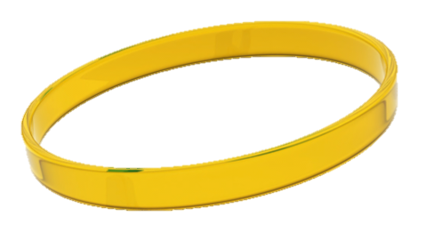
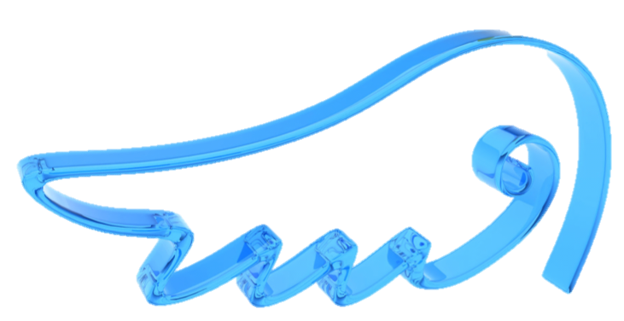
But, through prayer,
the enemy is defeated
and lives will be changed.
Eph. 6:10-18
What does the Bible say
about PRAYER?
Ask, and it will be given to you; seek, and you will find; knock, and it will be opened to you.
Matthew 7:7
If ye shall ask anything in my name, I will do it.
John 14:14
Pray without ceasing.
1 Thessalonians 5:17
For where two or three gather in my name,
there am I with them.
Matthew 18:20
Therefore I tell you, whatever you ask in prayer, believe
that you have received it,
and it will be yours.
Mark 11:24
Believe in the power of prayer.
Notes:
Read the scripture passages aloud or let the group read them silently to themselves.
- Optional Activity -
Allow the group to silently read through the list of scriptures. Ask each member of your group to share which passage stands out most to them and why – or if they have another scripture passage about prayer that is especially meaningful to them.
IMPORTANT KEY POINT!
CLICK to animate the slide (the question “Do you believe in the power of prayer” appears). Close with a discussion around the following:
So we really have two questions we each need to answer:
Do I feel I am qualified to pray over someone else? (By this point, everyone should be able to answer “yes” to this one!) Again, we are saying “qualified” not yet equipped which we will learn next.
And then – more importantly -
Do I believe in my heart that my prayers are being heard? Do I truly believe in the power of prayer?
Even if you have a bit of lingering doubt about your answer to #1 - if your answer is a resounding “yes” to this question, then you are ABSOLUTELY qualified!

Slide 9
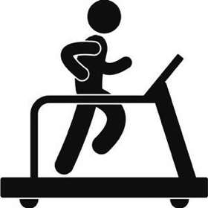




% of Prayer Requests by Category
60-70%
Use traditional prayer process.
Examples include: fitness, marriage, healthy pregnancy, safety of family, etc.
General Request(s)
Health/Fitness
Successful marriage
Being a good parent
Help for others they know
Elderly parent(s)
Notes:
“So we’ve addressed some of the the potential fears – about not being qualified or worthy for this ministry. However, there may also be a bit of a ‘fear of the unknown.’ We don’t know what types of prayer requests people may bring forward. So let’s review what’s been the experience of other popwe Ground Teams in this ministry.”
Explain that based on past experience, the vast majority of requests will be “general requests” – such as these. Many of us may pray for these types of things every day in our own lives.
For these types of requests, you will use the traditional prayer process – which we will teach you in just a few minutes.

Slide 10





% of Prayer Requests by Category
20-30%
Use traditional prayer process AND direct to local resources, if known. Also stress the importance of filling in the tear-off card.
Examples include: immediate health concern (cancer, MS, diabetes, etc.), addiction, etc.
Targeted Request(s)
Immediate Medical Issue
Cancer Diagnosis
Drug Addiction
Alcohol Abuse
Other
Notes:
Explain that a smaller portion of the prayer requests that come forward may be more targeted – such as the examples we see here.
For these requests, you will use the traditional prayer process – with a couple of important additions.
If you have any available local resources that could be helpful (e.g. cancer support group, addiction counseling, etc), be sure to mention these and provide additional information as appropriate.
When we walk through the prayer process, we’ll look more closely at the Day One booklets. These will be provided as a take-away to each person you pray with – and they include a tear-off card at the back. This card provides a place for them to fill in their contact information – which can allow Pastor Joe West and the popwe team to follow-up, as needed.

Slide 11






% of Prayer Requests by Category
0-5%
NEED HELP NOW ZONE - If this person is in immediate need of support, please bring him/her directly to Joe West or another pastor onsite.
Examples include: suicidal thoughts, unwanted pregnancy, abuse, etc.
Urgency/Crisis Mode
What if someone says that they want to give their life to Christ?
That is the BEST kind of urgent need! ☺ You have 2 options:
Use the Day One Booklet (see the pages titled “Prayer” and “The Journey Begins”) and/or
Walk them over to Joe or the Ground Team Leader for further assistance.
Suicidal Thoughts
Domestic Violence
Unwanted Pregnancy
Other*
*Note: For any situation that you’re not sure how to handle, please do not hesitate to enlist the help of the ground team leader.
Notes:
“Now I know what you are thinking…’But what if I get the exception to these rules??’”
Explain that there is an exceptionally small chance that you may have someone come forward with a more urgent need – someone who is really in a crisis mode.
If this is the case – you simply explain that you want to bring their request to another team member who might be better equipped to help them. And then walk them over to _________.
Note to Facilitator: You need to fill in the blank with the right name(s) for your event. This could be Pastor Joe West and/or it could be a pastor from your church. If you are unsure of who would be the right person for your event, contact Pastor Joe West to talk further.
Explain that there is another need they may see that is URGENT in the best way possible. Talk through the two options outlined on the slide for someone who comes forward wanting to accept Jesus into their heart for the first time.
Pause here and ask for any questions or reactions to the type of prayer requests they might expect.

Slide 12
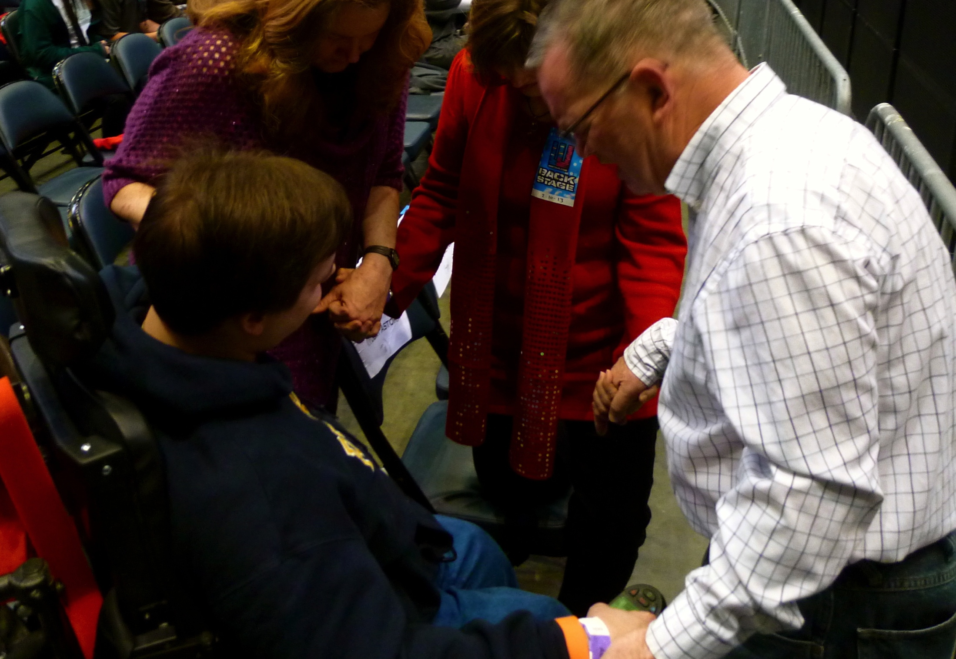


Overview of Prayer Process
I. ASK 3 opening questions.
  Ask follow-up questions, as needed.
  Goal is to be able to make your prayer personal.
II. PRAY together.
  Use provided prayer template(s), if desired.
III. PROVIDE a copy of the ALL IN booklet and prayer card.
  Ask them to fill out the card and return to you.
I.
II.
III.
ASK
THREE
OPENING
QUESTIONS
Notes:
“Now that we are convinced that we are the right people for this calling – and we know a little more about what types of prayers we might be asked to provide, let’s walk through the simple 3-step process that we’ll use to pray.”
“When we talk about “praying over someone” – some of us may be able to visualize exactly how we would do that. But for others, having a simple process that we can use will help us feel more comfortable and confident in this role.”
Review the three steps on the slide, and explain that in the next few slides, you will dig deeper into each step. Again, this process is meant to guide and create confidence, not to limit or confine.

Slide 13

Part I: Opening Questions
❶ Introduce yourself and ask their name.
❷ Ask about their experience at the concert/event.
❸ Open a dialogue.
  Is there anything in particular the God put on your heart tonight?
  Is there anything that you would like to pray about together?
As they begin to share, guide them to a quiet place; you want to be visible, but private.
Position yourself so that your back is to the crowd.
Notes:
Explain that Step I is to ask three opening questions.
Review the questions on the slide. Stress that this opening is intended to be very conversational and to minimize any potential awkwardness as an individual comes forward.
Remind the group that just coming forward may be a very big step for some – so we want to be welcoming and approachable.

Slide 14

Part I: Guidelines for Follow-Up Questions
(continued)
Objective(s):
Uncover the REAL concern; many start in the safe zone
Get specific enough to offer up a prayer; move to Level II
LEVEL 1 – Sample responses to your opening question
I’m going through a tough time.
I’m struggling right now in my marriage.
I’m worried about my child.
I have a health issue.
LEVEL 2 – Sample replies you could offer
I’m sorry to hear that…can you tell me a little more?
That must be hard. What sort of guidance or help would you like to ask God for tonight?
Note: Once you feel you have a good understanding of the need – engage in the prayer process.
Notes:
Explain that as you open a dialogue with your third question – some may start at what we’ve dubbed “Level 1” or the “safe zone.” Meaning, they may give you a very general/broad response.
Your goal then is to ask a few follow-up questions to gather enough information that your prayer can be more personal.
Read through the sample responses under Level 1, and the sample replies under Level 2.
You may shift into role playing a scenario right here – such as:
Let’s say a man comes forward. You introduce yourself and find out his name is Mike. You ask him – “Is there is anything in particular you would like to pray about together?” And they respond, “Yes – I’m going through a tough time right now.” You don’t want to launch right into a prayer – “Lord, please help Mike, as he’s going through a tough time.” You want to ask him to tell you a little more – encourage him to share what he’s struggling with – so that your prayer can be most meaningful for him.”
Once you feel that you have a good understanding of their need, shift to Step II – Pray Together.

Slide 15
Part II: Pray Together
Use the customizable “scripted” prayer, or the “outline” prayer.
Or, if you are comfortable, pray in your own words.
CONCLUDE WITH–
Thank you for coming forward to pray. Before you leave, I’d like to provide you with a resource that we hope will help you continue on a prayerful path…
Notes:
Have each person take out their Prayer Card.
Read the two prayer options out loud – the “scripted” prayer on one side, and the “outline” prayer on the other.
Explain that if they find it helpful, the intent is for them to carry this card with them and hold it in their hands as they pray. (They need to keep this card for use during the event.)
Remind the group members that it is absolutely fine for them to pray in their own words if they are comfortable doing so.
After they pray, they should transition to the final step of the process (see language at bottom of slide).

Slide 16
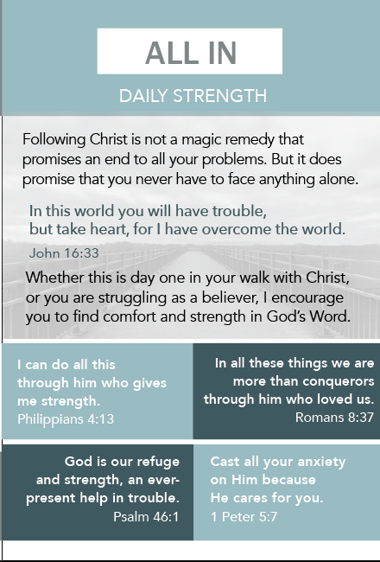
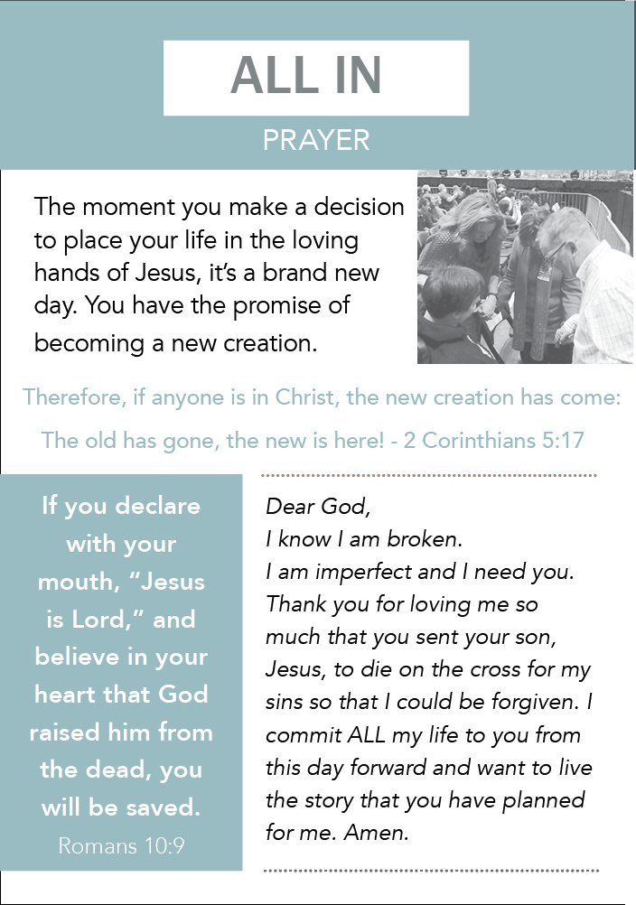
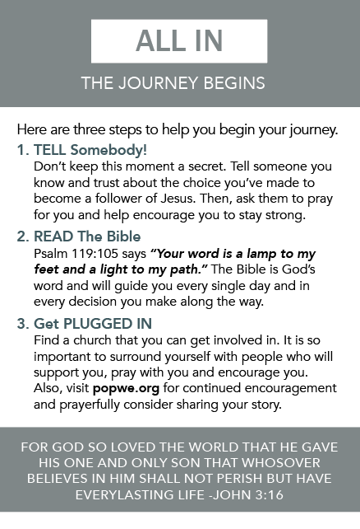
Part III: Provide the ALL IN Booklet
Provide a copy of the booklet; this is for them to take home.
Note: These will be available the night of the event
You may also want to call their attention to the pages titled: Daily Strength • Prayer • The Journey Begins
Notes:
Explain that Part III is to provide a copy of the DAY ONE booklet as a take-away
This resource is designed for the individual to read on their own after the show/event. It provides them with a guide to continued prayer as well as several scripture verses that they may find helpful.
Ask each person to take out their copy of the booklet. Briefly walk through each page together so that everyone is familiar with the resource.
You may want to give special focus on the pages listed on the slide (Daily Strength, Prayer, and The Journey Begins). These are pages that the Ground Team Members may want to point out to the individual they are praying with, based on their needs.
Remind the group that they can have this copy for themselves and that many more will be available the during the event for them to distribute.

Slide 17
Part III: The Prayer Card
Note: Any specific prayer requests will be added to our master prayer list
[Name} – it was great to meet you. I will keep you in my prayers. May God bless you!
Notes:
Finally, stress the importance of having each person they pray with complete the tear-off card.
Explain that:
This card provides a way for the popwe team to follow-up with individuals as needed. This information will not be shared outside of popwe.
Each Ground Team member will be given a popwe apron to wear the night of the concert/event. The apron has pockets for their supplies – their individual prayer card, the Day One booklets, and a pen.
Once they’ve given the booklet and briefly explained its purpose, they should actually hand the individual a pen and ask them to complete the card before they move on to pray with another individual.
At the end of the night, the Ground Team Leader will collect all of these cards and give them to Joe West (or another member of the popwe team).
Explain that once the candidate has completed the card, the ground team member can close by saying something like (read the line on the bottom of the slide).
Pause here to ask what questions the group may have about the 3-step prayer process.

Slide 18
Additional Roles of the Ground Team
Our wish is that every member will be able to pray with those who need prayer during and after the concert. There are also other ways the Ground Team will serve, in addition to prayer, beforehand and during intermission at the concert.
Chalk Wall – some Ground Team members will help facilitate guests who wish to write on our Chalk Wall. They can write their identities on the “Hello My Name Is” side and prayer requests on the back side!
iPad Sign Up – one team member will carry around an iPad asking people if they would like to sign up for DAY ONE DEVOS. An iPad tutorial will be located online.
Merch Bags – Ground Team Members will help pass out bags that give some info about popwe and the resources we provide to concert goers.
All In Stories – One Ground Team member will help facilitate the iPad collecting “All In” stories that will serve as inspiration for others and will be features on some of our devotions. Ryan, our fan engagement manager, will be on site to explain how it works.
Notes:
Read each description of the additional responsibilities.
Then, choose two people who feeling comfortable working on the ipads for #2 and #4, and email the names of those people to erica@populationwe.com so she can be in touch with them with instructions.

Slide 19
Event Expectations
Your admission is free; please purchase tickets for family and friends.
Please arrive 90 minutes before “doors open.”
Note: Doors typically open one hour before the show start time.
Assemble as a group for our pre-concert huddle.
Receive your individual name tag and green apron.
Collect a small supply DAY ONE booklets, pens,
and your prayer card.
Locate where you will be serving if you are not currently praying with someone: ie. Facilitating chalk wall, collecting ’All In’ stories, using iPad…
Enjoy the show!
Q&A
Up next…
ground team
Notes:
“Let’s finish our session with a few important logistical items…”
Read through the Event Expectations listed on the slide.
Your group may have questions – so we’ve tried to answer the most FAQs on the next few slides.
If you are asked a question that you aren’t sure of the answer to – please reach out to the popwe team and we’ll help you find out!

Slide 20
Event Expectations
Q&A
Q. Can I sit with my family/friends during the show?
A. Yes, please do. The exception will be in venues with assigned seating.
ground team
Notes:
Be sure to know your venue and whether seats are individually purchased or if the tickets are general admission.

Slide 21
Event Expectations
Q&A
Q. What if no one comes to me after the show for prayer?
Every show is different. If no one comes to you, find another team member and assist them. Or, if you see a group of people waiting for autographs or merchandise, feel free to engage them in a conversation about popwe and ask if they’d like access to our free DAY ONE DEVOS! And - we hope that learning the prayer process is a gift, and one that we hope you use well after the show.
ground team
Notes:
Depending on your group and your interest, you may even consider hosting a post-session event in the days following the show. It would be great for the members to share what they learned, how they felt, places they’ve used the prayer process outside of this event, etc.

Slide 22
Event Expectations
Q&A
Q. Will we get to meet Matthew and the band?
A. MW is very appreciative of you serving this ministry and will do everything he can to spend time with the team in prayer ahead of the show. However, there are times when circumstances may prevent him being able to join you.
ground team

Slide 23
Event Expectations
Q&A
Q. Are all of the volunteers with ?
A. No. It takes many hands to make a concert work and there will be volunteers for the merchandise table, ushers, employees of other non-profit ministries, etc. Look for the green aprons to find our group.
ground team

Slide 24

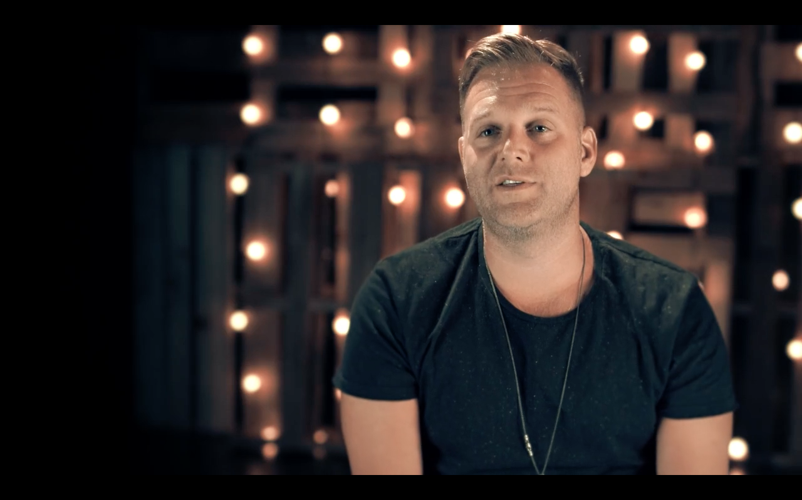
THANK YOU FROM MATTHEW WEST
Click here to play video
Then I heard the voice of the Lord saying, “Whom shall I send? Who will go for us?” And I said “Here I am. Send me.” Isaiah 6:8
Notes:
I. Let me share one final video message from Matthew.
Click on the video thumbnail to play the video. (If you click elsewhere on the slide, it will end the slideshow.)
II. Debrief by:
Asking each person to share ONE reflection about this session.
Reminding everyone to continue to lift the popwe prayer requests.
Asking each person to practice the prayer process with others, especially their loved ones.
Close in prayer. You may use the following prayer, which includes several of the prayer requests from the handout – or you can pray your own.
Lord, we thank you for bringing us together and calling us to this ministry. We truly believe that you hear and answer our prayers. We ask for your blessings for:
Our upcoming Matthew West show – and all of the upcoming shows on his fall tour – that you may show your presence to all who attend..
Those who will attend – that they may experience salvation and healing through the music and those they encounter at the show.
All those associated with the show – Matthew, the band, the crew, other musicians – for their health and safe travel.
All of us tonight – that by serving others in this ministry, our own faith and our belief in the power of prayer may be strengthened.
And for our own needs – those we’ve prayed for together, and those we hold deep in our hearts.
It is written in Isaiah: Then I heard the voice of the Lord saying, “Whom shall I send? Who will go for us? And I said “Here I am. Send me.”
Bless us as you send us forth to do your work.
Father, we lift these prayers in the name of Jesus, your Son.
Amen.
Thank everyone for coming!

