Slide 1


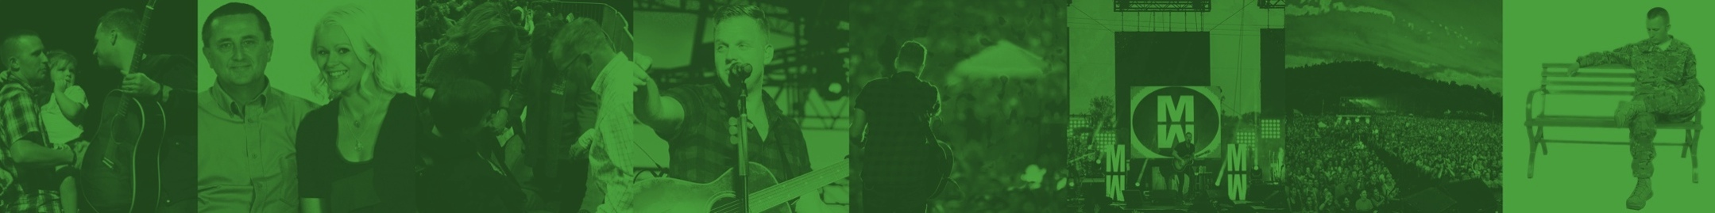


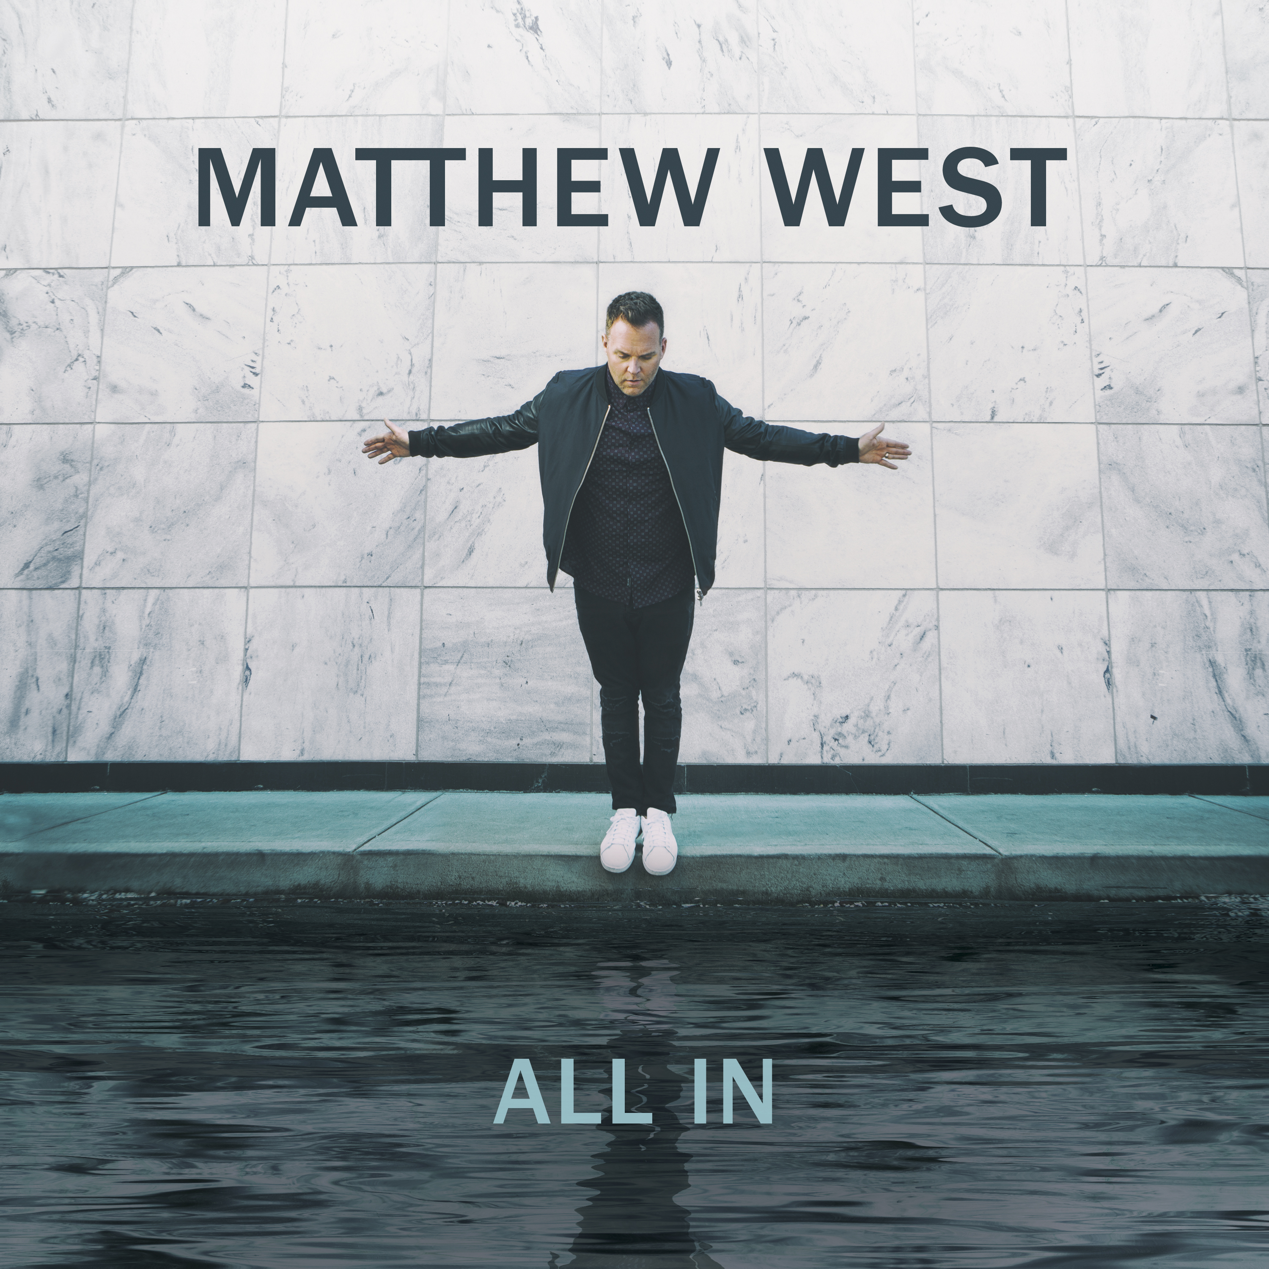
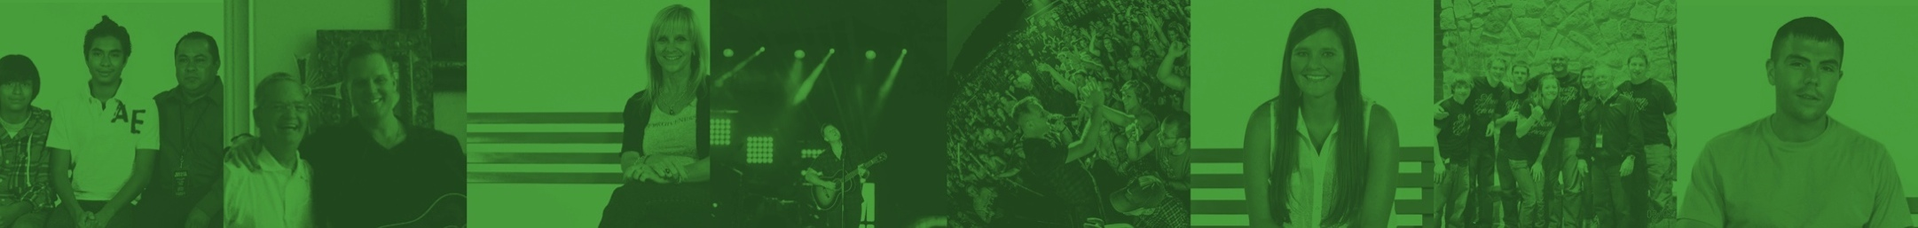
As each has received a gift, use it to serve one another,
as good stewards of God’s varied grace.
1 Peter 4:10
2017 INFORMATIONAL SESSION
welcome to the
GROUND TEAM
2017 - ALL RIGHTS RESERVED.
Notes:
As a reminder – be sure to play Matthew West’s CD, or your favorite Matthew West online streaming station, as guests are arriving to help set the tone for the session.
Greet your team as they arrive and welcome them - introduce yourself to anyone you haven’t worked with before.
Once everyone is seated and you are ready to begin, call their attention to the scripture verse at the top of this slide.
Thank them for coming forward to use their gifts to be part of this ministry!

Slide 2
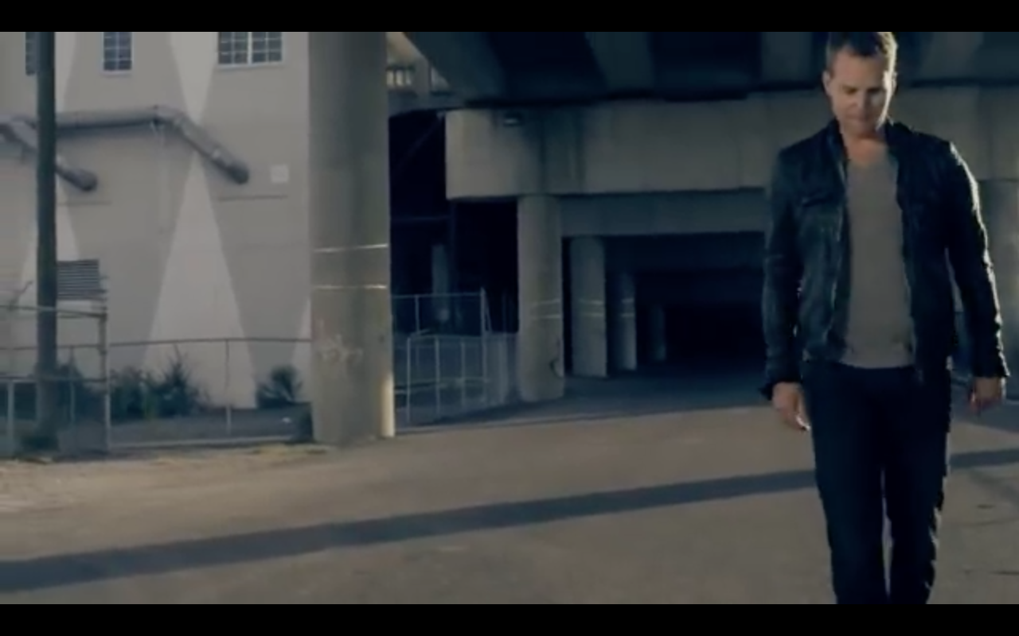

My Own Little World
I. Opening Prayer
II. Watch Video
III. Share
What if there’s a greater purpose I could be living right now?
Share your name and ONE thing about yourself
Offer ONE thing that inspired you from the video/song
Briefly share ONE way prayer has served in your life
Notes:
Begin your session with an opening prayer.
Open with a prayer of your choice, or feel free to use this prayer – which is actually written into the song “My Own Little World” –
Father, break my heart for what breaks yours. Give me open hands and open doors. Put your light in my eyes and let me see that my own little world is not about me.
After you lead the group in an opening prayer, click to play the video. It will open in full screen. When the video finishes, it will take you back to this slide.
Watch the video of Matthew West’s song – My Own Little World
After the video – you may want to make a comment like: “If you’re like me, when you saw this video, you saw something of yourself. I asked each of you here tonight because I think you have that same desire that Matthew wrote about in this song – a desire to move outside of our own little world – to help others in need.”
Introduce yourselves to one another
You may choose to have each person answer all three of the items to share, or have each person choose one of the three (preferred).

Slide 3
Session Objectives
1
2
3
INTRODUCE
EQUIP
INSPIRE
purpose of popwe
Ground Team for success
hope through prayer and the “power of story”
We want this to be a meaningful
experience every step of the way –
and our hope is that the impact of this session will go far beyond our upcoming concert/event.
Thank you, in advance, for your interest in serving on the Ground Team!
Notes:
“Now that we’ve learned a little about each other, here’s what we are going to work to accomplish tonight.”
Read the 3 objectives on the slide.
Click to advance the slide.
Then, please read the following note from the popwe team:
Our ministry is passionate about taking Christian music beyond entertainment. Your desire to help with this local event is tremendous and LIVES WILL BE CHANGED as a result of the prayers that are lifted that night and after. However, we also pray that the team you have assembled will learn meaningful insights during this session that they will then share with family, friends, and others in the community. The power of prayer is truly God’s gift to us. Believing in that power creates miracles on earth. We will spend time on the prayer process and belief in that process later in the session. Thank you for being part of this Ground Team and for helping to make miracles happen!
“Let’s hear more about the story behind popwe from Matthew West.”
When you click to advance to the next slide, it will automatically launch into the video for the song.

Slide 4
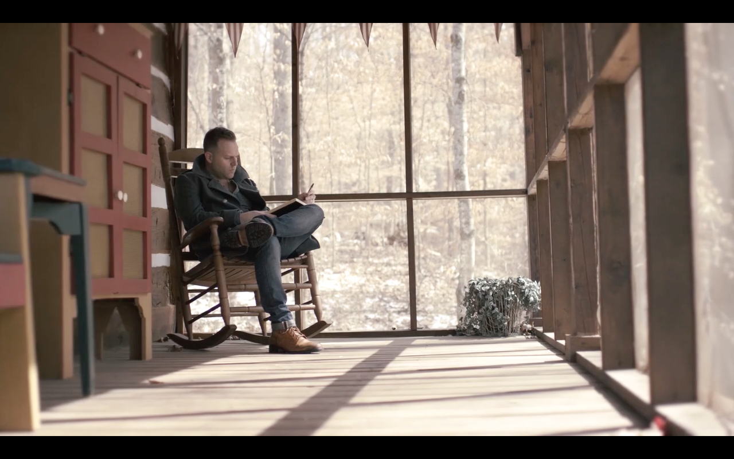
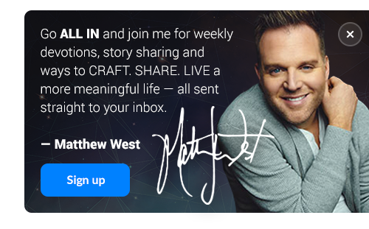
Click here to play video
Learn how popwe serves
Learn about the Story Behind Stories
Call to Action
Notes:
“To help INTRODUCE us to the mission of popwe, let’s listen to Matthew West share the story behind his call to build this ministry.”
Play the Intro video.
Click on the video thumbnail to play the video. (If you click elsewhere on the slide, it will end the slideshow.)
After the video, you may want to say something like:
“Now, let’s take a deeper look at how Matthew West’s ministry, popwe, serves.”

Slide 5
The 4 ways popwe serves
popwe serves with Ground Team members to pray for those who request prayer and further follow up after Matthew West concerts and events
Concert Prayer Ministry
popwe features stories on our website of God’s great impact in the world in hopes that others will share their stories with the world.
Storytelling
Portal
POPWE.ORG
popwe creates a free weekly DAY ONE DEVOS, as well as resources to teach people how to CRAFT. SHARE. and LIVE. a more meaningful story with their lives.
Ministry
Resources
popwe has relationships with other ministries that we partner with prayerfully and financially and are able to refer people to these ministries based on their specific needs and resources.
Feeder
Foundation
Notes:
The purpose of this slide is so that the Ground Team can be informed about popwe and be able to share that information with those who ask about popwe during the concert.
Read through each way popwe serves
- You can let people know that they can visit popwe.org for a deeper look into the 4 ways we serve and to see the resources we offer.
Now, let’s look at what popwe believes.

Slide 6

popwe’s Statement of Faith
We believe there is one God.
2. We believe that salvation is available to anyone who believes in Jesus.
3. We believe the Bible is the infallible Word of God and the ultimate source of truth.
4. We believe that God still works in our lives in incredible ways.
5. We believe that Heaven is the hope.
WE BELIEVE…
Notes:
Pass out copies of the statement of faith to each Ground Team Member.
Because we are representatives of Matthew West’s ministry at the concert, it is important for us to know and represent what popwe believes.
Give everyone time to read over the Statement of Faith and read this slide aloud to them. Once everyone has had time to look it over, have everyone sign the Statement of Faith and hand them back to you so that you can keep them and bring them to Pastor Joe West at the show, or you can scan them over to erica@populationwe.com.
- After this slide, you may want to say something like:
“During Matthew’s concerts, Matthew shares the inspiration behind many of his songs that have been written based on powerful stories of God’s great impact in people’s lives. Many members of the audience are affected by these stories in profound ways and will be inspired to seek prayer or help if they can relate to those stories. Let’s take a look at one of those stories:”

Slide 7
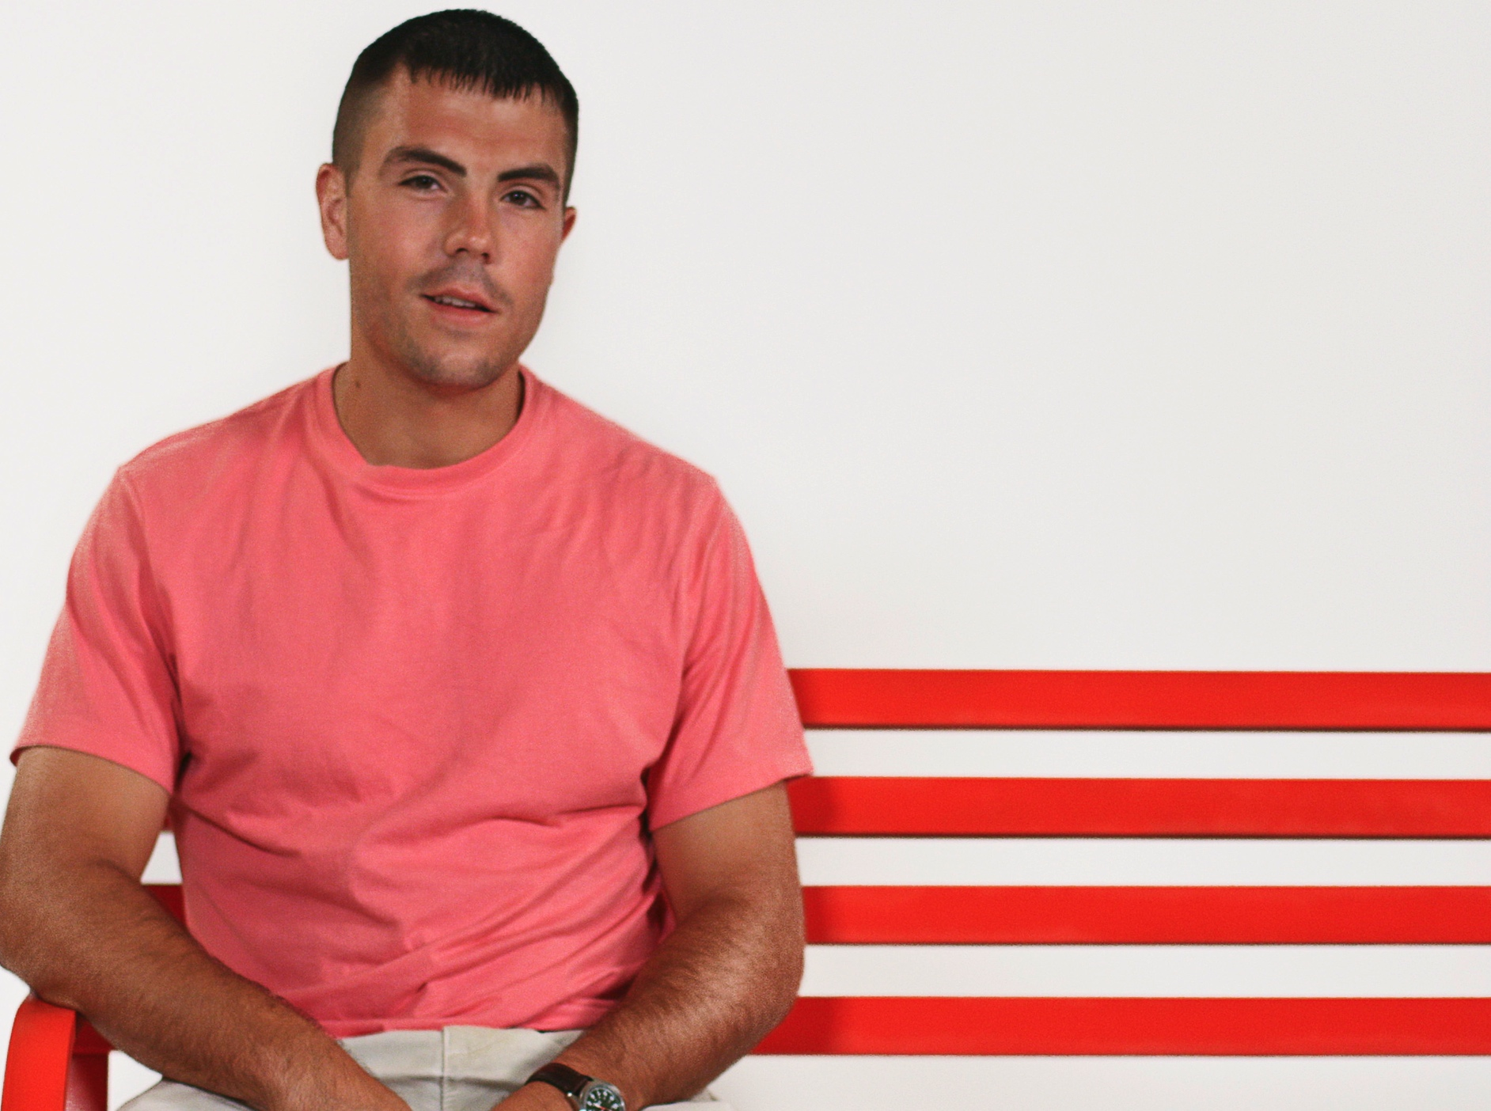


Power of Story – Example
Hello, My Name Is
READ Jordan’s story.
POWER OF STORY
LISTEN to MW’s song.
SHARE reactions during lightning round.
Notes:
“This story centers around Jordan and the personal challenge that he faced.”
Explain that you will READ Jordan’s story, LISTEN to the song it inspired, and SHARE our reactions.

Slide 8

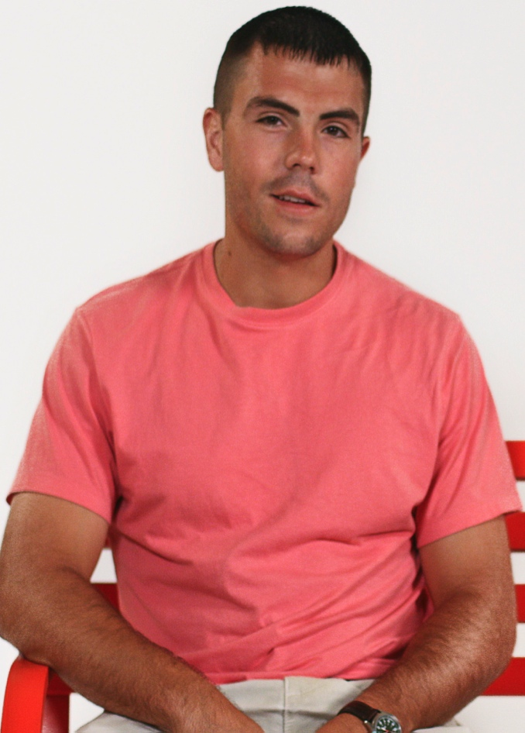
“Hello, my name is Jordan and I am a drug addict.” That was the first sentence of this young man’s story. As a two sport all-star athlete in high school, Jordan received a college scholarship to run track and play football at a university in Kentucky. During his sophomore season, Jordan broke his ankle. That is when he received his first prescription to Oxycontin. His addiction quickly took hold of his life and sent him spinning out of control. After two failed drug tests, the university kicked him out and removed his sports scholarships. Jordan had lost everything for which he had worked so hard.
Lost and out of control, Jordan needed help. His parents showed their deep love for their son by courageously entrusting his healing and recovery to Teen Challenge in North Carolina. Teen Challenge is a Christian rehabilitation center with a mission of restoring lives with the hope of Jesus Christ. Jordan said it was during his time in Teen Challenge that he began to realize that God wasn’t done with him yet, and that all of those defeating titles like “addict,” didn’t have to be attached to his name for the rest of his life.
Since his recovery, Jordan went back and got his master’s degree from the very college that kicked him out. Now, he is a teacher, a coach, and a newlywed. And, he has recently felt God calling him into full-time ministry. Jordan says about his identity, “These days I introduce myself a little differently than I used to. Hello, my name is Jordan and I am a CHILD OF THE ONE TRUE KING!”
Let’s listen to the song he inspired right now!
Power of Story –
POWER OF STORY
Hello, My Name Is
Notes:
A copy of this story is also available in your Facilitator Guide. The words will scroll up on their own (do not click). Either read it out loud or ask the group to read it individually to themselves.
When you click to advance to the next slide, it will automatically launch into the video for the song.

Slide 9

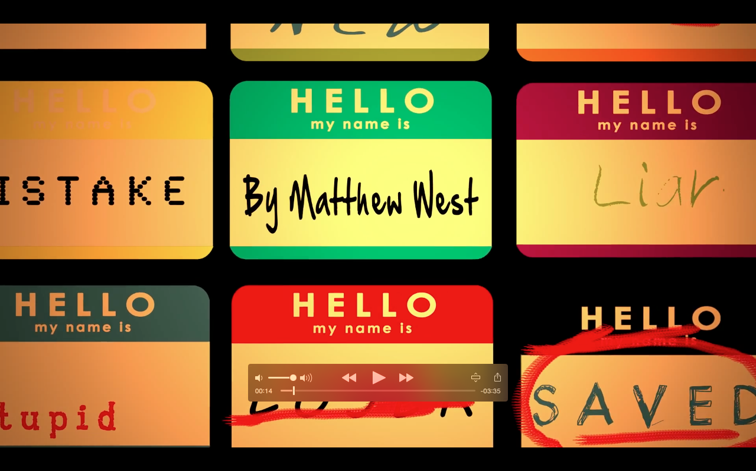
Power of Story
Hello, My Name Is
POWER OF STORY
Notes:
If for any reason you are unable to play the video, you can also launch it from www.vevo.com (search for Matthew West – then select “Hello My Name Is Lyric Video).

Slide 10
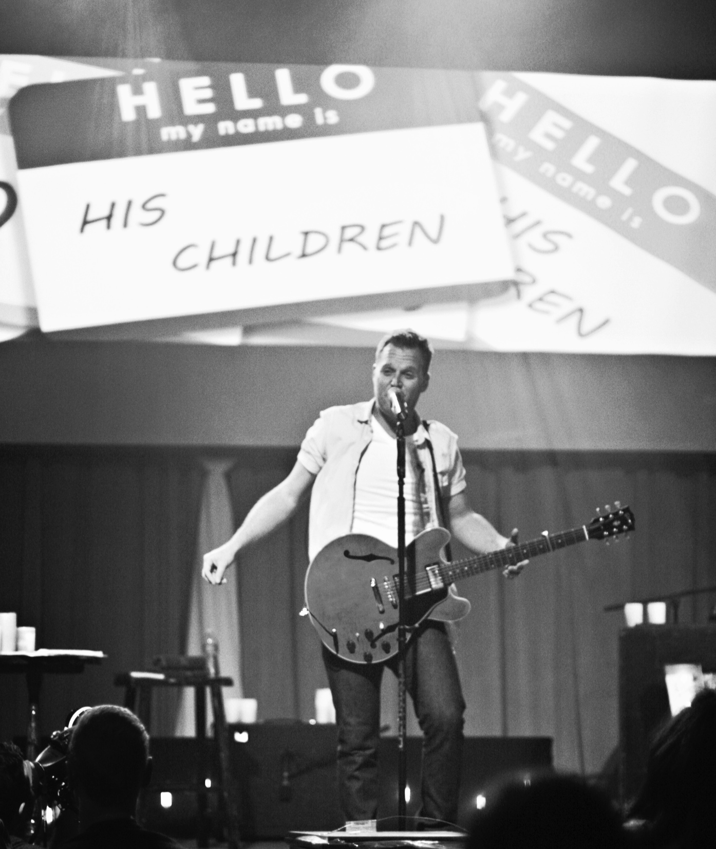

Power of Story – Example
Hello, My Name Is
POWER OF STORY
LIGHTNING ROUND
Offer ONE thing that inspired you from the video/song.
Notes:
Engage in a “Lightning Round” to encourage the group to share their thoughts/reactions to Jordan’s story.
IMPORTANT KEY POINT: Close the discussion by summarizing the key take-aways from both stories. For example – you might say something like:
“Although Jordan’s story is more personal to his struggle with addiction – even if we haven’t faced that specific challenge in our own lives, we each have our own challenges to overcome. My hope is that you feel inspired by his will to overcome and his belief that God saw something more for him.
Jordan is living proof of the power of story. Through Jordan’s decision to act and the courage to share, Jordan’s story has impacted and inspired others to do the same.”

Slide 11
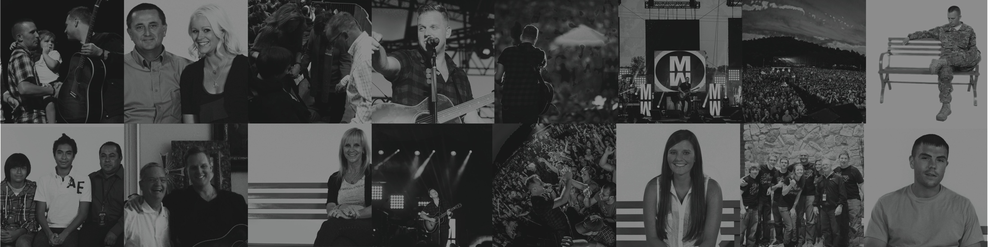
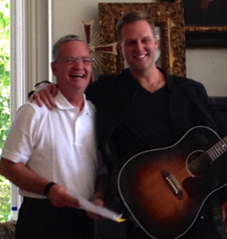
Roles and Responsibilities
ground team
Notes:
“Now that we’ve introduced you to popwe, and been inspired by the “power of story” – let’s shift into our next objective for our session: EQUIPPING you to serve at our upcoming concert/event.”

Slide 12

ENCOURAGE individuals to trust that God is the author of their story
PRAY for those who request prayer during or after the show
REMIND everyone to sign up at popwe.org for complimentary access to DAY ONE DEVOS
ENGAGE with concert goers and be equipped to share how popwe serves and what resources we offer
PRAY
Together, we will review -
Prayer Resources
Trouble-shooting
Follow-through
YOUR STORY, HIS GLORY
GROUND TEAM
Notes:
Explain that the role of the Ground Team Members at the event is two-fold:
To pray with concert-goers who come forward during and after the show.
Engage with concert goers in a meaningful way
“The primary focus of our role as a Ground Team is to pray with those who come forward. As we discussed earlier, this process can change lives and we hope that you will take what you learn during this session and share with others.”

Slide 13
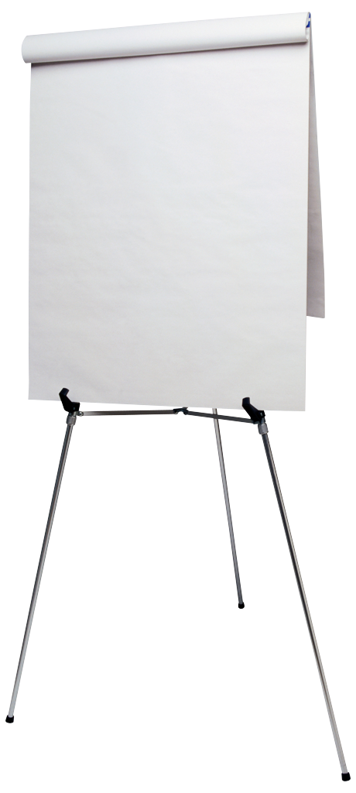
overcoming
I’m not a pastor.
I haven’t been trained.
I don’t know what to say.
I feel “weird” doing it.
What if I say the wrong thing?
I’m not worthy to pray over someone else.
FEAR
About the PRAYER PROCESS
most common concerns
Notes:
“Before we talk about HOW we should pray over others – let’s first talk through some of the potential fears that could be associated with this ministry.”
Note to Facilitator: The goal on this slide is to reassure the group that any fears they might have are totally normal – and shared. Through the next few slides, you will help them realize how they can easily overcome any fears they may have.
- Optional Activity -
If you have a flipchart available, ask the group to brainstorm a list of potential fears about a prayer ministry. This allows them to voice their own concerns.
Once you have a list of 5 or so items, click to display the list in the blue box. Most likely, the two lists will be very similar.
If you choose not to do the optional flipchart activity –
Click to display the list in the blue box and discuss. You should expect to see a lot of heads nodding as you talk through this list of common fears/concerns.
Note that the last item on the list “I’m not worthy to pray over someone else” highlights in red as this is the most common and least likely to be voiced. The next slide bridges the last concern and seeks to overcome it.

Slide 14
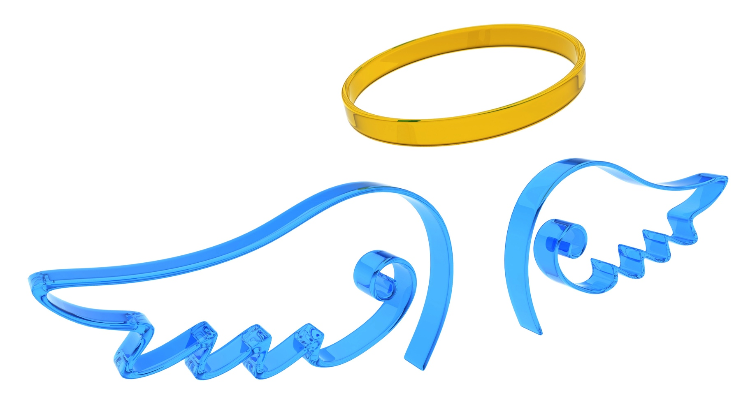
Angels don’t have to have wings -
Sometimes they are just ordinary people who come into our lives at the right time.
God does not call the qualified, He qualifies the called.
Notes:
Remind the group that God does not call the qualified – He qualifies the called.
“Each of us is not only worthy of praying over someone – but in fact, God has called us to prayer through scripture.

Slide 15
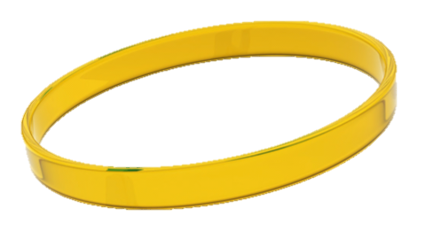
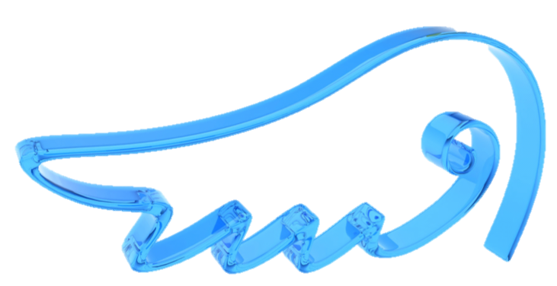
But, through prayer,
the enemy is defeated
and lives will be changed.
Eph. 6:10-18
What does the Bible say
about PRAYER?
Ask, and it will be given to you; seek, and you will find; knock, and it will be opened to you.
Matthew 7:7
If ye shall ask anything in my name, I will do it.
John 14:14
Pray without ceasing.
1 Thessalonians 5:17
For where two or three gather in my name,
there am I with them.
Matthew 18:20
Therefore I tell you, whatever you ask in prayer, believe
that you have received it,
and it will be yours.
Mark 11:24
Believe in the power of prayer.
Notes:
Read the scripture passages aloud or let the group read them silently to themselves.
- Optional Activity -
Allow the group to silently read through the list of scriptures. Ask each member of your group to share which passage stands out most to them and why – or if they have another scripture passage about prayer that is especially meaningful to them.
IMPORTANT KEY POINT!
CLICK to animate the slide (the question “Do you believe in the power of prayer” appears). Close with a discussion around the following:
So we really have two questions we each need to answer:
Do I feel I am qualified to pray over someone else? (By this point, everyone should be able to answer “yes” to this one!) Again, we are saying “qualified” not yet equipped which we will learn next.
And then – more importantly -
Do I believe in my heart that my prayers are being heard? Do I truly believe in the power of prayer?
Even if you have a bit of lingering doubt about your answer to #1 - if your answer is a resounding “yes” to this question, then you are ABSOLUTELY qualified!

Slide 16
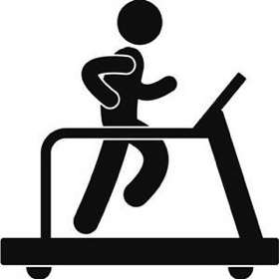




% of Prayer Requests by Category
60-70%
Use traditional prayer process.
Examples include: fitness, marriage, healthy pregnancy, safety of family, etc.
General Request(s)
Health/Fitness
Successful marriage
Being a good parent
Help for others they know
Elderly parent(s)
Notes:
“So we’ve addressed some of the the potential fears – about not being qualified or worthy for this ministry. However, there may also be a bit of a ‘fear of the unknown.’ We don’t know what types of prayer requests people may bring forward. So let’s review what’s been the experience of other popwe Ground Teams in this ministry.”
Explain that based on past experience, the vast majority of requests will be “general requests” – such as these. Many of us may pray for these types of things every day in our own lives.
For these types of requests, you will use the traditional prayer process – which we will teach you in just a few minutes.

Slide 17





% of Prayer Requests by Category
20-30%
Use traditional prayer process AND direct to local resources, if known. Also stress the importance of filling in the tear-off card.
Examples include: immediate health concern (cancer, MS, diabetes, etc.), addiction, etc.
Targeted Request(s)
Immediate Medical Issue
Cancer Diagnosis
Drug Addiction
Alcohol Abuse
Other
Notes:
Explain that a smaller portion of the prayer requests that come forward may be more targeted – such as the examples we see here.
For these requests, you will use the traditional prayer process – with a couple of important additions.
If you have any available local resources that could be helpful (e.g. cancer support group, addiction counseling, etc), be sure to mention these and provide additional information as appropriate.
When we walk through the prayer process, we’ll look more closely at the Day One booklets. These will be provided as a take-away to each person you pray with – and they include a tear-off card at the back. This card provides a place for them to fill in their contact information – which can allow Pastor Joe West and the popwe team to follow-up, as needed.

Slide 18






% of Prayer Requests by Category
0-5%
NEED HELP NOW ZONE - If this person is in immediate need of support, please bring him/her directly to Joe West or another pastor onsite.
Examples include: suicidal thoughts, unwanted pregnancy, abuse, etc.
Urgency/Crisis Mode
What if someone says that they want to give their life to Christ?
That is the BEST kind of urgent need! ☺ You have 2 options:
Use the Day One Booklet (see the pages titled “Prayer” and “The Journey Begins”) and/or
Walk them over to Joe or the Ground Team Leader for further assistance.
Suicidal Thoughts
Domestic Violence
Unwanted Pregnancy
Other*
*Note: For any situation that you’re not sure how to handle, please do not hesitate to enlist the help of the ground team leader.
Notes:
“Now I know what you are thinking…’But what if I get the exception to these rules??’”
Explain that there is an exceptionally small chance that you may have someone come forward with a more urgent need – someone who is really in a crisis mode.
If this is the case – you simply explain that you want to bring their request to another team member who might be better equipped to help them. And then walk them over to _________.
Note to Facilitator: You need to fill in the blank with the right name(s) for your event. This could be Pastor Joe West and/or it could be a pastor from your church. If you are unsure of who would be the right person for your event, contact Pastor Joe West to talk further.
Explain that there is another need they may see that is URGENT in the best way possible. Talk through the two options outlined on the slide for someone who comes forward wanting to accept Jesus into their heart for the first time.
Pause here and ask for any questions or reactions to the type of prayer requests they might expect.

Slide 19
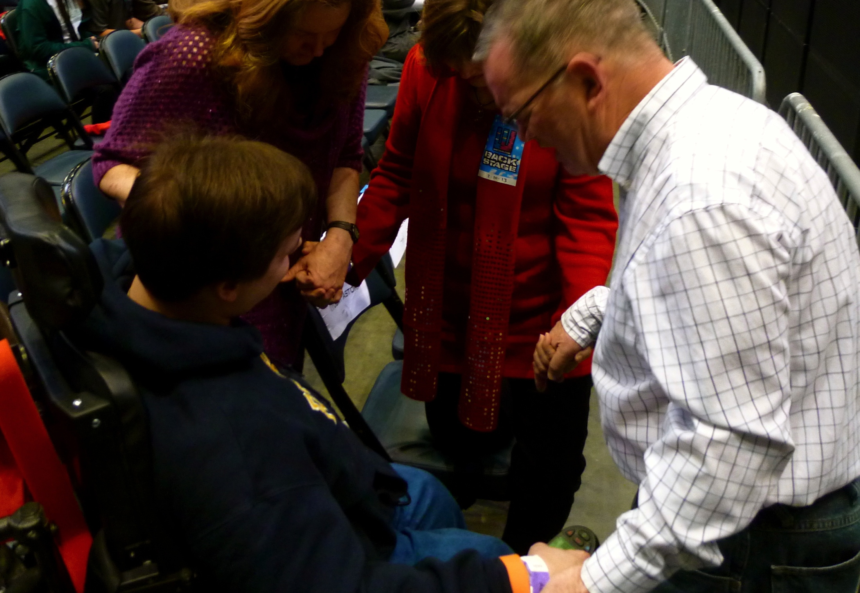


Overview of Prayer Process
I. ASK 3 opening questions.
  Ask follow-up questions, as needed.
  Goal is to be able to make your prayer personal.
II. PRAY together.
  Use provided prayer template(s), if desired.
III. PROVIDE a copy of the ALL IN booklet and prayer card.
  Ask them to fill out the prayer card and return to you.
I.
II.
III.
ASK
THREE
OPENING
QUESTIONS
Notes:
“Now that we are convinced that we are the right people for this calling – and we know a little more about what types of prayers we might be asked to provide, let’s walk through the simple 3-step process that we’ll use to pray.”
“When we talk about “praying over someone” – some of us may be able to visualize exactly how we would do that. But for others, having a simple process that we can use will help us feel more comfortable and confident in this role.”
Review the three steps on the slide, and explain that in the next few slides, you will dig deeper into each step. Again, this process is meant to guide and create confidence, not to limit or confine.

Slide 20

Part I: Opening Questions
❶ Introduce yourself and ask their name.
❷ Ask about their experience at the concert/event.
❸ Open a dialogue.
  Is there anything in particular the God put on your heart tonight?
  Is there anything that you would like to pray about together?
As they begin to share, guide them to a quiet place; you want to be visible, but private.
Position yourself so that your back is to the crowd.
Notes:
Explain that Step I is to ask three opening questions.
Review the questions on the slide. Stress that this opening is intended to be very conversational and to minimize any potential awkwardness as an individual comes forward.
Remind the group that just coming forward may be a very big step for some – so we want to be welcoming and approachable.

Slide 21

Part I: Guidelines for Follow-Up Questions
(continued)
Objective(s):
Uncover the REAL concern; many start in the safe zone
Get specific enough to offer up a prayer; move to Level II
LEVEL 1 – Sample responses to your opening question
I’m going through a tough time.
I’m struggling right now in my marriage.
I’m worried about my child.
I have a health issue.
LEVEL 2 – Sample replies you could offer
I’m sorry to hear that…can you tell me a little more?
That must be hard. What sort of guidance or help would you like to ask God for tonight?
Note: Once you feel you have a good understanding of the need – engage in the prayer process.
Notes:
Explain that as you open a dialogue with your third question – some may start at what we’ve dubbed “Level 1” or the “safe zone.” Meaning, they may give you a very general/broad response.
Your goal then is to ask a few follow-up questions to gather enough information that your prayer can be more personal.
Read through the sample responses under Level 1, and the sample replies under Level 2.
You may shift into role playing a scenario right here – such as:
Let’s say a man comes forward. You introduce yourself and find out his name is Mike. You ask him – “Is there is anything in particular you would like to pray about together?” And they respond, “Yes – I’m going through a tough time right now.” You don’t want to launch right into a prayer – “Lord, please help Mike, as he’s going through a tough time.” You want to ask him to tell you a little more – encourage him to share what he’s struggling with – so that your prayer can be most meaningful for him.”
Once you feel that you have a good understanding of their need, shift to Step II – Pray Together.

Slide 22
Part II: Pray Together
Use the customizable “scripted” prayer, or the “outline” prayer.
Or, if you are comfortable, pray in your own words.
CONCLUDE WITH–
Thank you for coming forward to pray. Before you leave, I’d like to provide you with a resource that we hope will help you continue on a prayerful path…
Notes:
Have each person take out their Prayer Card.
Read the two prayer options out loud – the “scripted” prayer on one side, and the “outline” prayer on the other.
Explain that if they find it helpful, the intent is for them to carry this card with them and hold it in their hands as they pray. (They need to keep this card for use during the event.)
Remind the group members that it is absolutely fine for them to pray in their own words if they are comfortable doing so.
After they pray, they should transition to the final step of the process (see language at bottom of slide).

Slide 23
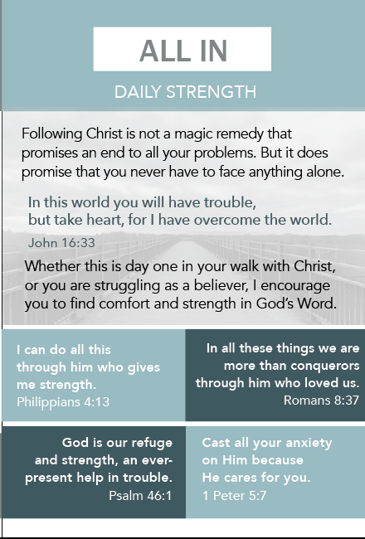
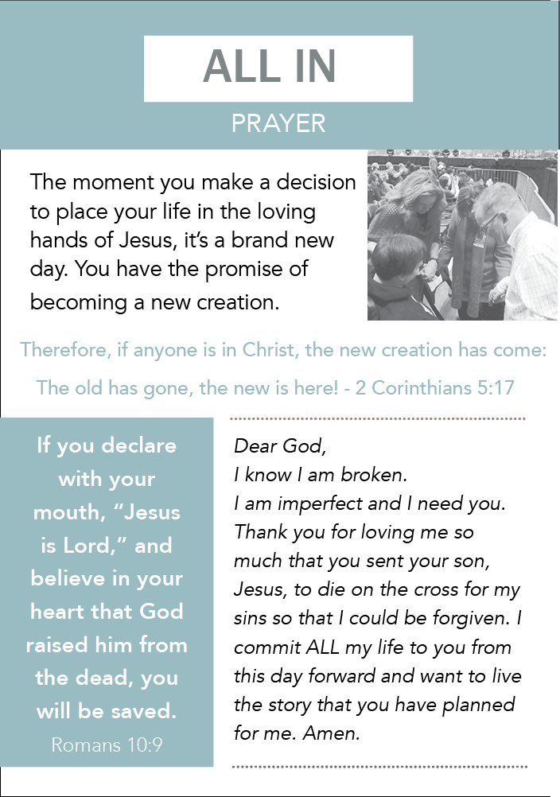
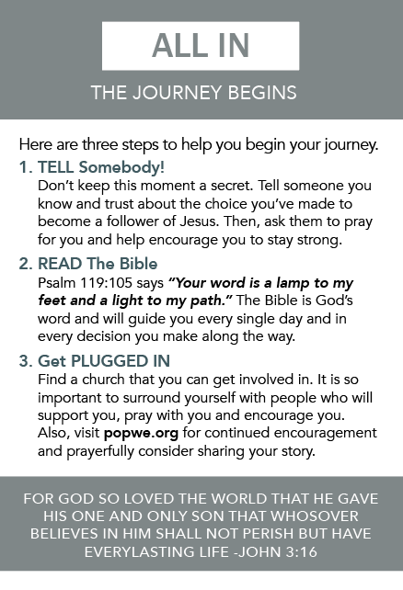
Part III: Provide the ALL IN Booklet
Provide a copy of the booklet; this is for them to take home.
Note: These will be available the night of the event
You may also want to call their attention to the pages titled: Daily Strength • Prayer • The Journey Begins
Notes:
Explain that Part III is to provide a copy of the DAY ONE booklet as a take-away
This resource is designed for the individual to read on their own after the show/event. It provides them with a guide to continued prayer as well as several scripture verses that they may find helpful.
Ask each person to take out their copy of the booklet. Briefly walk through each page together so that everyone is familiar with the resource.
You may want to give special focus on the pages listed on the slide (Daily Strength, Prayer, and The Journey Begins). These are pages that the Ground Team Members may want to point out to the individual they are praying with, based on their needs.
Remind the group that they can have this copy for themselves and that many more will be available the during the event for them to distribute.

Slide 24
Part III: The Prayer Card
Note: Any specific prayer requests will be added to our master prayer list
[Name} – it was great to meet you. I will keep you in my prayers. May God bless you!
Notes:
Finally, stress the importance of having each person they pray with complete the prayer card.
Explain that:
This card provides a way for the popwe team to follow-up with individuals as needed. This information will not be shared outside of popwe.
Each Ground Team member will be given a popwe apron to wear the night of the concert/event. The apron has pockets for their supplies – their individual prayer card, the ALL IN booklets, and a pen.
Once they’ve given the prayer card and briefly explained its purpose, they should hand the individual a pen and ask them to complete the card before they move on to pray with another individual.
At the end of the night, the Ground Team Leader will collect all of these cards and give them to Joe West (or another member of the popwe team).
Explain that once the candidate has completed the card, the ground team member can close by saying something like (read the line on the bottom of the slide).
Pause here to ask what questions the group may have about the 3-step prayer process.

Slide 25



Role
play
ASK 3 opening questions.
ASK
THREE
OPENING
QUESTIONS
PRAY together using the prayer card.
PROVIDE the
Day One booklet.
the prayer process
Notes:
“Now that we understand the 3-step prayer process, let’s try it for ourselves. A role play will give us a chance not only to “practice before the real thing” – but it will also give us the opportunity to experience what it FEELS like to be prayed over. “
Divide your group into pairs. (If there are an odd number of people, you can be a partner to one.)
Explain that:
They should choose who will be the Ground Team Member and who will be their person being prayer over. (They will each have a turn to play each role.)
They should role play the 3-step process as if they had just met after the concert.
If you are the person being prayed over, offer something real in your life that you’d like to pray for.
They should switch roles in about 5 minutes.
After we’ve each played both roles, we’ll come back together as a large group and talk about our experience.
IMPORTANT KEY POINT: “Remember: It’s less important whether you use all the right words, but more important that your belief in the power of prayer comes through behind your words!”

Slide 26

Share your thoughts on the prayer process.
Describe how you felt as you were praying.
Describe how it felt being prayed over.
Debrief
the prayer process
Notes:
Spend a few minutes to debrief the role play using the three discussion starters on the slide.
IMPORTANT KEY POINT:
Here’s what we hope you hear in your debrief!
The 3-step process is simple to remember and feels very natural.
It felt good to pray for someone – and it felt even better to have someone pray for me!
I could use this 3-step process with my spouse, children, in other church groups – this was really worthwhile!

Slide 27
Event Expectations
Your admission is free; please purchase tickets for family and friends.
Please arrive 2 hours before “show time.”
Assemble as a group for our pre-concert huddle.
Receive your individual name tag and green apron.
Collect a small supply ALL IN booklets, pens,
and your prayer card.
Enjoy the show!
Q&A
Up next…
ground team
Notes:
“Let’s finish our session with a few important logistical items…”
Read through the Event Expectations listed on the slide.
Your group may have questions – so we’ve tried to answer the most FAQs on the next few slides.
If you are asked a question that you aren’t sure of the answer to – please reach out to the popwe team and we’ll help you find out!

Slide 28
Event Expectations
Q&A
Q. Can I sit with my family/friends during the show?
A. Yes, please do. The exception will be in venues with assigned seating.
ground team
Notes:
Be sure to know your venue and whether seats are individually purchased or if the tickets are general admission.

Slide 29
Event Expectations
Q&A
Q. What if no one comes to me after the show for prayer?
Every show is different. If no one comes to you, find another team member and assist them. Or, if you see a group of people waiting for autographs or merchandise, feel free to engage them in a conversation about popwe and ask if they’d like access to our free DAY ONE DEVOS! And - we hope that learning the prayer process is a gift, and one that we hope you use well after the show.
ground team
Notes:
Depending on your group and your interest, you may even consider hosting a post-session event in the days following the show. It would be great for the members to share what they learned, how they felt, places they’ve used the prayer process outside of this event, etc.

Slide 30
Event Expectations
Q&A
Q. Will we get to meet Matthew and the band?
A. MW is very appreciative of you serving this ministry and will do everything he can to spend time with the team in prayer ahead of the show. However, there are times when circumstances may prevent him being able to join you.
ground team

Slide 31
Event Expectations
Q&A
Q. Are all of the volunteers with ?
A. No. It takes many hands to make a concert work and there will be volunteers for the merchandise table, ushers, employees of other non-profit ministries, etc. Look for the green aprons to find our group.
ground team

Slide 32
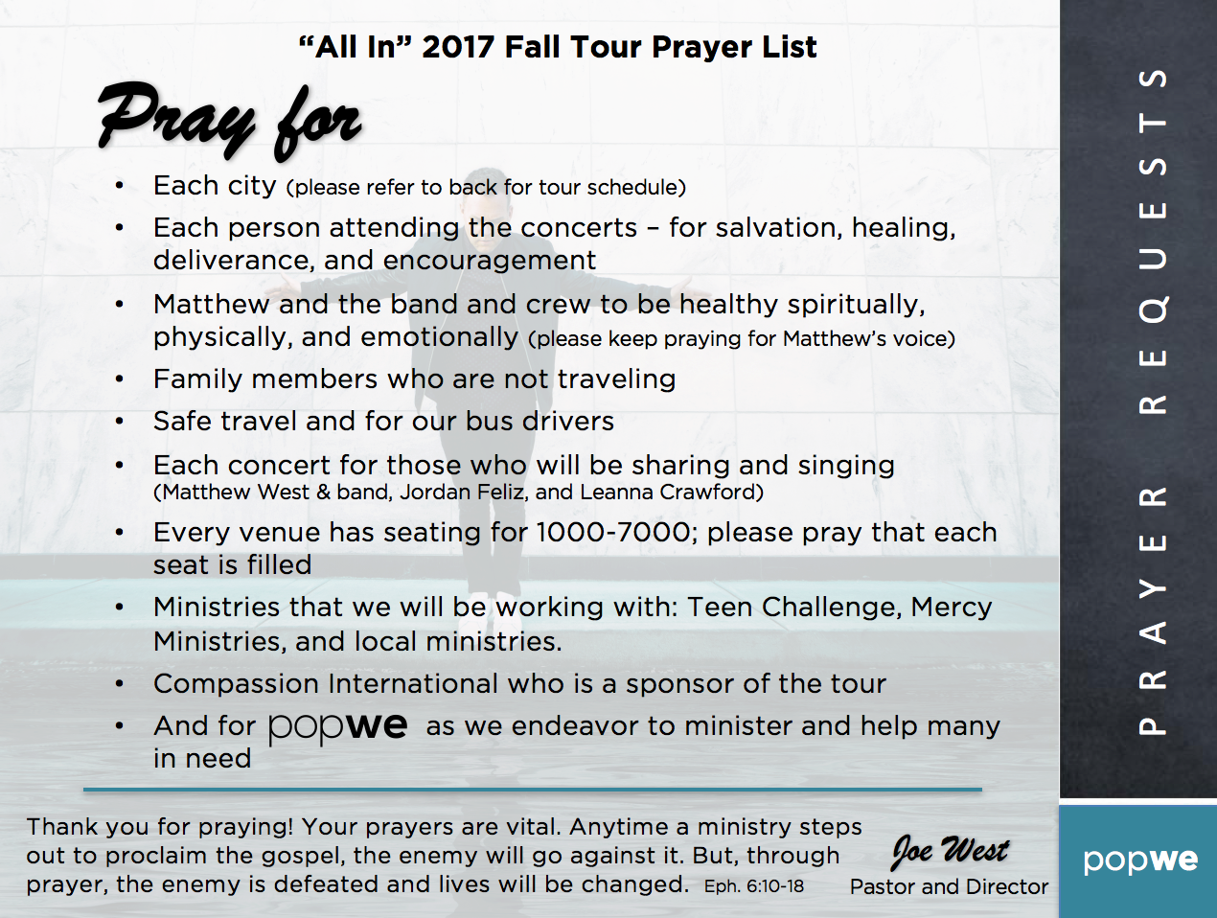
2017 Prayer Requests
TAKE A COPY of these prayer requests as you leave the session.
PRAY THESE PRAYERS everyday leading up to the concert.
BELIEVE that God will touch the hearts and minds of those attending!
THANK YOU!
Notes:
“Before we conclude, I’d like to call your attention to one last item. Since our ministry is focused on prayer – it seems only fitting that we would each commit to praying every day between now and the concert/event.”
Ask everyone to take out their copy of the Prayer Requests sheet. Explain that this is a list of prayers that we are asked to lift up each day.
“Perhaps most importantly – let’s commit to praying that God will touch the hearts and minds of all those who attend the event – including each of ours!”

Slide 33

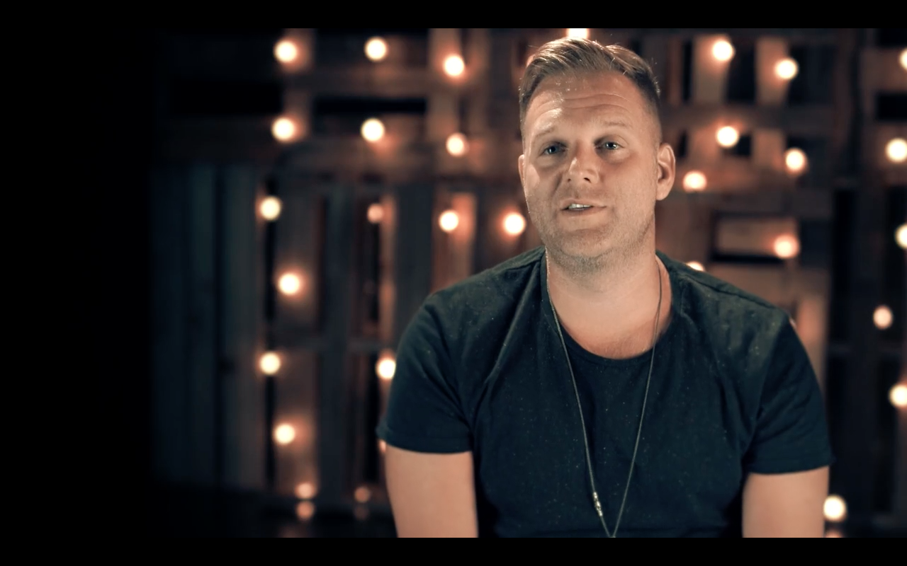
I. Watch Video
II. Debrief
III. Closing Prayer
Click here to play video
THANK YOU FROM MATTHEW WEST
Share ONE reflection about this session
Continue to lift up the popwe prayer requests
Practice the prayer process; share this gift with your loved ones
Then I heard the voice of the Lord saying, “Whom shall I send? Who will go for us?”
And I said “Here I am. Send me.” Isaiah 6:8
Notes:
I. Let me share one final video message from Matthew.
Click on the video thumbnail to play the video. (If you click elsewhere on the slide, it will end the slideshow.)
II. Debrief by:
Asking each person to share ONE reflection about this session.
Reminding everyone to continue to lift the popwe prayer requests.
Asking each person to practice the prayer process with others, especially their loved ones.
Close in prayer. You may use the following prayer, which includes several of the prayer requests from the handout – or you can pray your own.
Lord, we thank you for bringing us together and calling us to this ministry. We truly believe that you hear and answer our prayers. We ask for your blessings for:
Our upcoming Matthew West show – and all of the upcoming shows on his fall tour – that you may show your presence to all who attend..
Those who will attend – that they may experience salvation and healing through the music and those they encounter at the show.
All those associated with the show – Matthew, the band, the crew, other musicians – for their health and safe travel.
All of us tonight – that by serving others in this ministry, our own faith and our belief in the power of prayer may be strengthened.
And for our own needs – those we’ve prayed for together, and those we hold deep in our hearts.
It is written in Isaiah: Then I heard the voice of the Lord saying, “Whom shall I send? Who will go for us? And I said “Here I am. Send me.”
Bless us as you send us forth to do your work.
Father, we lift these prayers in the name of Jesus, your Son.
Amen.
Thank everyone for coming!

